Slide 1
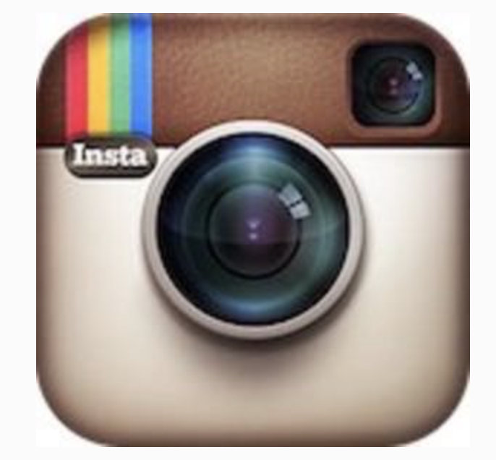
Burbn let users check in at particular locations, make plans for future check-ins, earn points for hanging out with friends, and post pictures of the meet-ups.
People weren't using Burbn's check-in features at all. What they were using, though, were the app's photo-sharing features.
After months of experimentation and prototyping—on October 12, 2010—Systrom and Krieger released a simple photo-sharing app. It was named not Burbn, but Instagram.

Slide 2
What was instagram created for?
"Our goal is to not just be a photo-sharing app, but to be the way you share your life when you're on the go," Kevin Systrom says

Slide 3
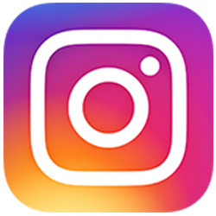
What is it being used for today?
Popularity Contest: The more likes the more popular you are.
You gain more likes if you go to the trendier places.
Companies create hyper-real experiences with the purpose of taking images as a form of advertisement.
People have the need to share, therefore create experiences that they may or may not enjoy.

Slide 4
https://www.buzzfeed.com/francineroettger/65-of-the-most-instagrammable-food-spots-in-nyc-307sw?utm_term=.eneqJ8xxR#.qe2LaeQQJ
http://www.thisisinsider.com/how-instagram-has-completely-changed-the-way-we-eat-2017-8

Slide 5
A system was created to enable people to share their unique experiences but today people have the need to constantly share what they are doing so they create experiences that they may or may not even like. These experiences are also being manufactured based on trends and popular cultures and the point of having unique experiences has disappeared. Everyone is sharing the same experiences.

